Slide 1



Smart Elevator System
Latifah Faiz ALmuqibel - 224012252
Sara Ali Alsagoor - 224006758
Rawdah Salah Alnaim - 224006975
Maryam Hajji Alhajji - 224009328
Dr. Hala Hamdoun

Slide 2


Project Summary
This C++ program simulates an elevator system that handles and processes floor requests from users in a building. The main goal is to manage requests in a structured way and determine if access to specific floors is allowed based on the time of day.

Slide 3

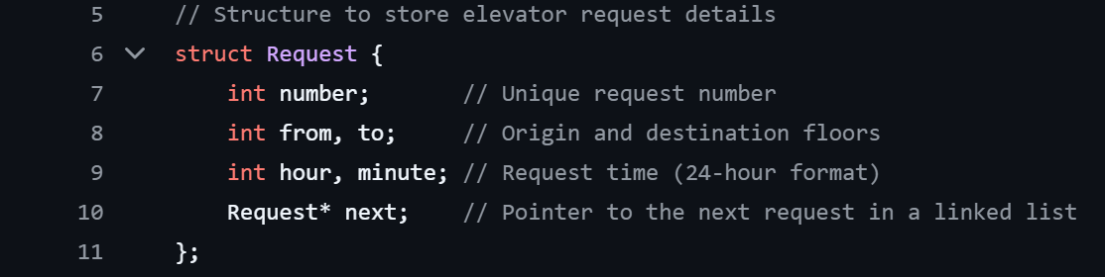

The Request structure represents a single elevator request. It stores:
• number: A unique identifier for each request.
• from / to: The floor where the person is and where they want to go.
• hour / minute: The time the request was made.
• next: a pointer to the next request in the list. It’s used for both
queue and the request history.
Maryam

Slide 4
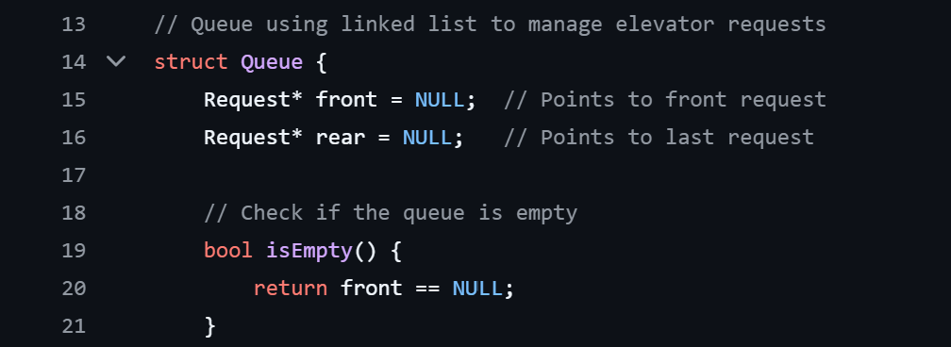
Queue struct : This is a simple linked list-based queue used to manage elevator requests.
isEmpty boolen : This function checks if the queue is empty by seeing if front is null (meaning no items in queue) :
• true if the queue is empty.
• false if it has at least one request.
Maryam

Slide 5
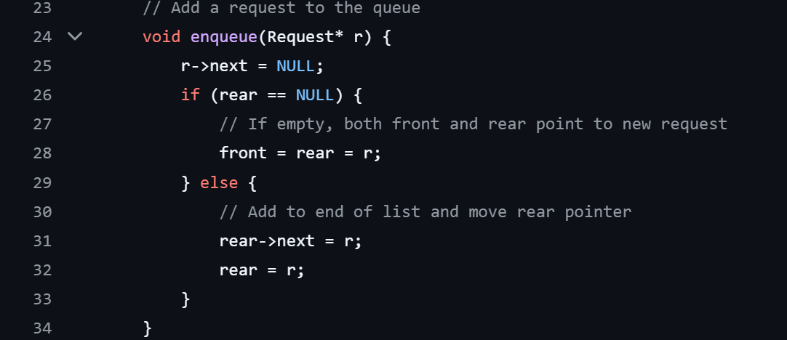
This function adds a request (r) to the end of the queue:
• If the queue is empty, it sets both front and rear to the new request.
• Otherwise, it attaches it to the current rear and moves rear forward.
Maryam

Slide 6
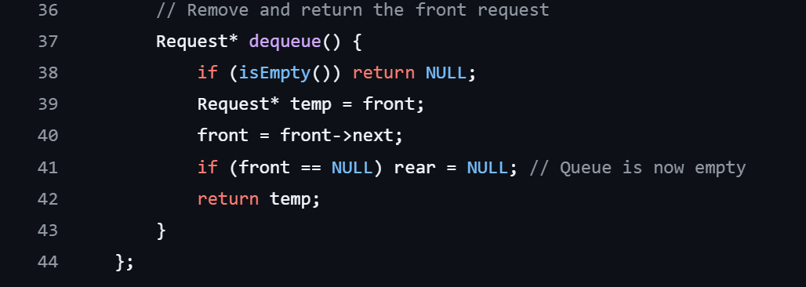
This function removes the first request from the queue and returns it:
• It stores the current front in temp.
• Moves front to the next item.
• If that was the last item, it also clears rear.
Maryam

Slide 7

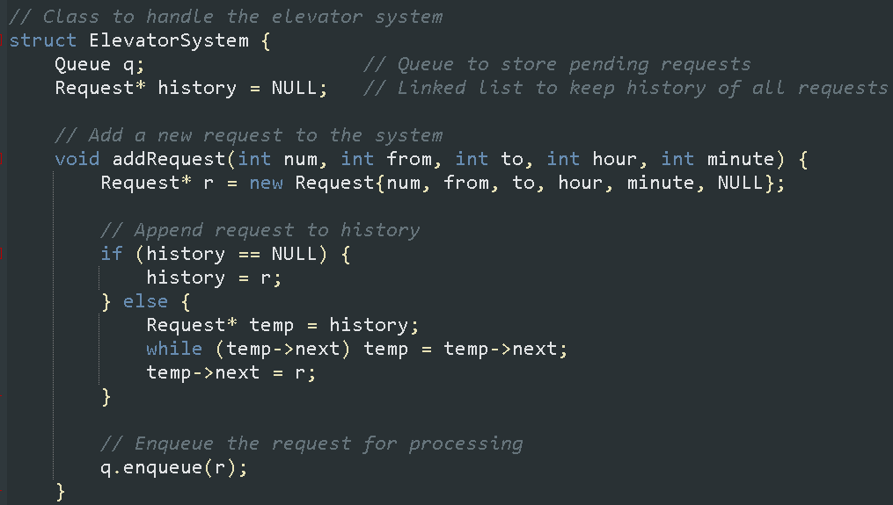

The addRequest function creates and adds a new request to a system. It takes five parameters—num, from, to, hour, and minute—to initialize a new Request object. This new request is first appended to a linked list called history, which stores all past requests. If history is empty, the new request becomes the first element; otherwise, it is added to the end of the list. After storing the request in the history, it is then enqueued into a queue q for further processing. This function ensures both record-keeping and processing of incoming requests.
Sara

Slide 8
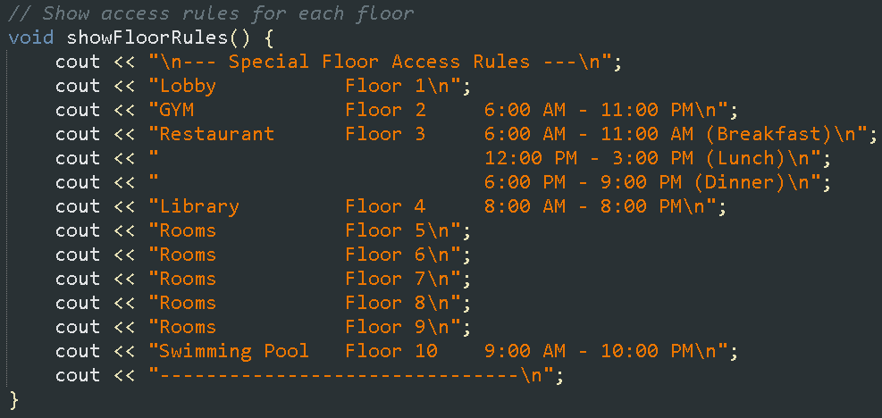

The showFloorRules function prints out the access rules for each floor in a building. It shows what is on each floor, like the gym, restaurant, or rooms, and includes the opening hours for places that have time limits. This helps users know when and where they can go in the building.
Sara

Slide 9
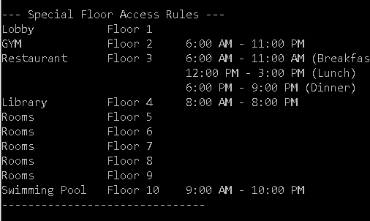
Output
Sara

Slide 10
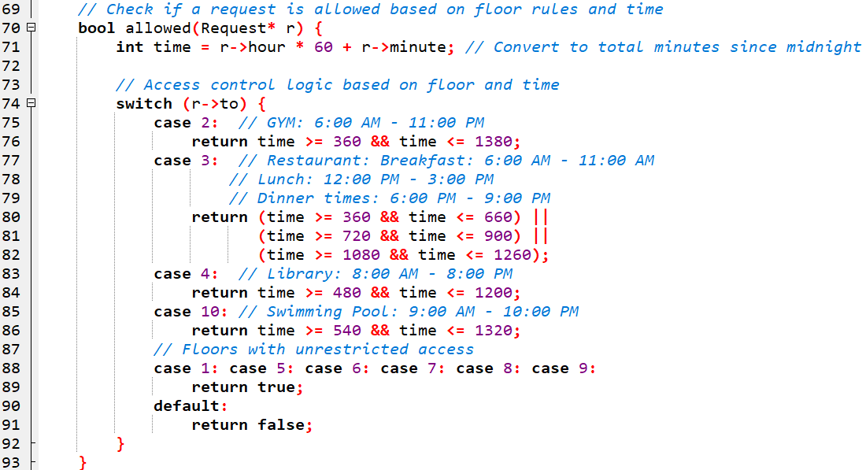
The allowed() function checks if a user’s request to access a specific floor is within the allowed time menu. It converts the hour and minute into total minutes, then uses a switch statement to validate access based on the destination floor’s rules. Some floors have specific access hours, while others are always allowed.
Latifah

Slide 11


Output
Floor 1: Lobby
Floor 2: GYM 6:00 AM - 11:00 PM
Floor 3: Restaurant
Floor 10: Pool 9:00 AM - 10:00 PM
Latifah

Slide 12


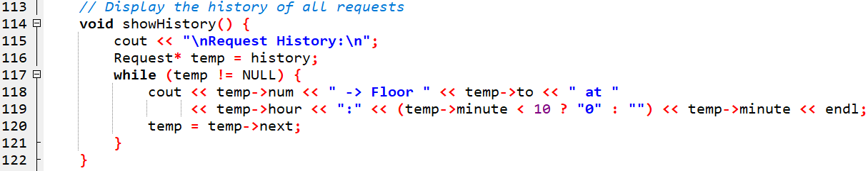
The ShowHistory() function displays all the elevator requests made so far. It starts from the beginning of the request list and goes through each one, printing the floor number and the time the request was made, until it reaches the end of the list.
Latifah

Slide 13


Output
Floor 2: GYM 6:00 AM - 11:00 PM
Floor 10: Pool 9:00 AM - 10:00 PM
Floor 5
Latifah

Slide 14
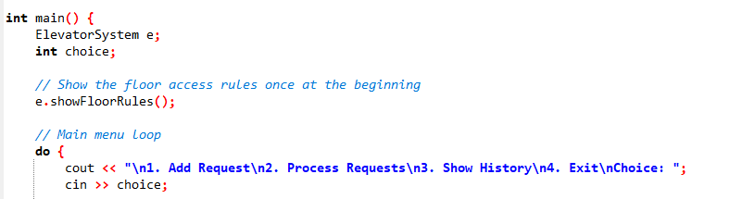
The main() function is the program's core. It begins by creating an ElevatorSystem object to manage elevator operations. A key part of main() is a do-while loop that displays a menu to the user, offering choices like adding requests, processing them, viewing history, or exiting. User input drives the program's flow.
Rawdah

Slide 15
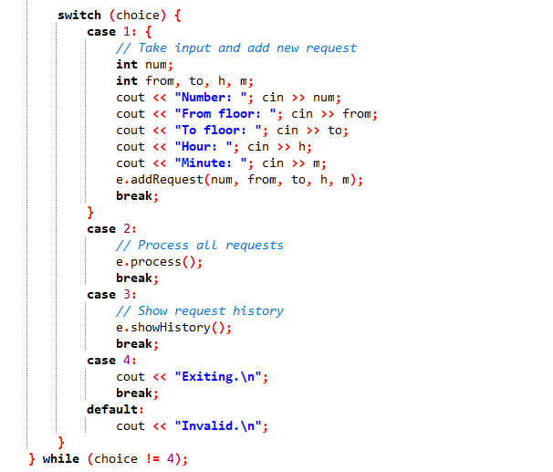
A switch statement then executes the code corresponding to the user's selection: adding a request involves gathering request details and calling addRequest(); processing calls process(), which operates on the queue (q) of pending elevator requests. It uses a while loop to iterate as long as the queue is not empty, ensuring that all requests are serviced; showing history calls showHistory(), which is responsible for displaying the record of all elevator requests that have been made, and exiting terminates the loop.
Rawdah

Slide 16
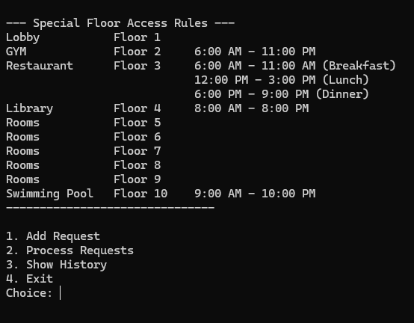
Output
Rawdah

